Slide 1
WELCOME to NIH Grant Writing Workshops funded through the RIMI grant

Slide 2
Pre-Award Office at Fresno State: ORSP
Nancy Myers Sims, Grants & Contracts Development Specialist

Slide 3
ORSP: Who are we?
Pre-award office
Authorized official for grants/contracts
State employees
We are NOT the Foundation!!!
Notes:
This PowerPoint template is designed to assist you in creating your own university-branded presentation.
You may alter the text boxes or graphic elements in the template to accommodate your content. Please do not alter the background image.
If you need assistance with this template, please contact the Office of University Communications at 559.278.8595.

Slide 4
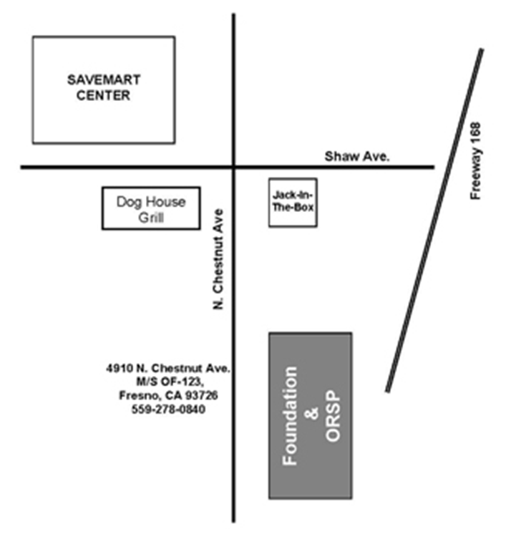
Where are we?
Office location:
4910 N. Chestnut Ave
Behind Jack-in-the-Box at Shaw and Cedar (in Foundation Building)

Slide 5
Key Responsibilities
~400 external proposals and contracts per year
prior to PROPOSAL SUBMISSION
Develop Policies and Conduct Proposal-Writing Workshops
Identify Funding Sources & Facilitate Contacts with Agencies
Assist in Proposal Planning (especially institution-wide)
Write, co-write, edit, organize proposals
Insure compliance with policies, guidelines and regulations
Conflict of Interest Human Subjects
Animal Care and Use Budgetary Restrictions
Institutional Approvals IDC and Cost Sharing
Obtain Internal Approvals and Submit Proposals
Facilitate PI communication with funding agency

Slide 6
Key Responsibilities
After Submission
For Rejected Proposals:
Analyze Panelist/Reviewers Comments
Make Recommendations for Resubmission
Provide Grief Counseling and Consolation
For Successful Proposals:
Negotiate Required Changes, Conditions
Transfer to Post-Award to Establish Grant Accounts
Provide Ongoing Assistance and Communications

Slide 7
Key Responsibilities
in addition to PROPOSAL SUBMISSION
Facilitate Student Research
Develop and Implement Policies
Provide Internal $ Support
Handle Patents and Intellectual Property Matters
Raise Visibility of Research and Outreach

Slide 8
What ORSP CAN do… if given enough time
Assist with writing/editing proposal narratives
Review Proposals Prior To Submittal
Provide “boilerplate” info
Search for Funding Sources
Attend meetings to discuss proposal development

Slide 9
What ORSP MUST Do
Develop itemized budgets
Prepare grant apps for on-campus approvals
Ensure that agency and university guidelines are followed
Negotiate contract offers and details on behalf of university/Foundation
Conduct review of all contracts and obtain signatures
Submit grant application to funding agency

Slide 10
When to Contact ORSP (grant manager)
As soon as you have an idea
for external funding

Slide 11
Contacts
Nancy Myers Sims
nmyers@csufresno.edu, X0836
Doug Carey
dcarey@csufresno.edu, X0964
Ellen Shimakawa
eshimakawa@csufresno.edu, X0863

Slide 12
Website
http://www.fresnostate.edu/academics/grants

Slide 13
Questions?

