Slide 1
Library Collection Budget
Kimberley Smith, Collection Strategist
Dolly Lopez, Electronic Resources Librarian

Slide 2
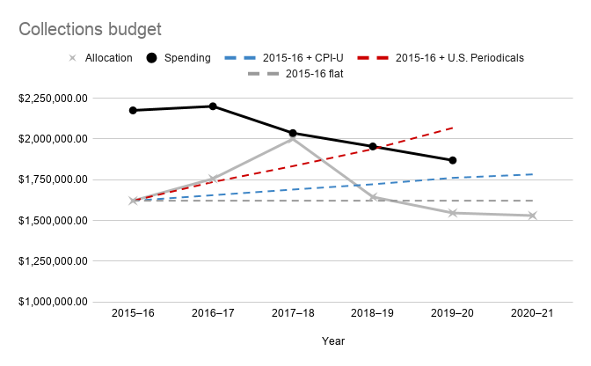
Fluctuating collections budget
Source: https://www2.calstate.edu/csu-system/administration/sdlc/Pages/library-statistics-reports.aspx
Source: http://www.ala.org/alcts/resources/collect/serials/spi

Slide 3
Previous cancellations
First wave of cancellations (2019-2020):
91 journals; 10 journal packages/databases
Cut near $200,000
Low hanging fruit: low usage; high cost
Second wave of cancellations (2020-2021):
A committee was formed to address a $423,666 projected cut.
49 journals; 25 journal packages/databases; 21 standing orders (amounting to about $182,000+)
Fell short of goal but provided a series of recommendations in our collections review report.

Slide 4
Standards for Libraries in Higher Education
“The Association of College and Research Libraries (ACRL), the largest division of the American Library Association, establishes criteria for standards and guidelines for academic librarianship along with frameworks for information literacy.
Collections: Libraries provide access to collections sufficient in quality, depth, diversity, format, and currency to support the research and teaching missions of the institution.
Educational Role: Libraries partner in the educational mission of the institution to develop and support information-literate learners who can discover, access, and use information effectively for academic success, research, and lifelong learning.
Discovery: Libraries enable users to discover information in all formats through effective use of technology and organization of knowledge”
Source: http://www.ala.org/acrl/standards/standardslibraries
Notes:
I’m going to jump in here. These are my personal opinions.

Slide 5
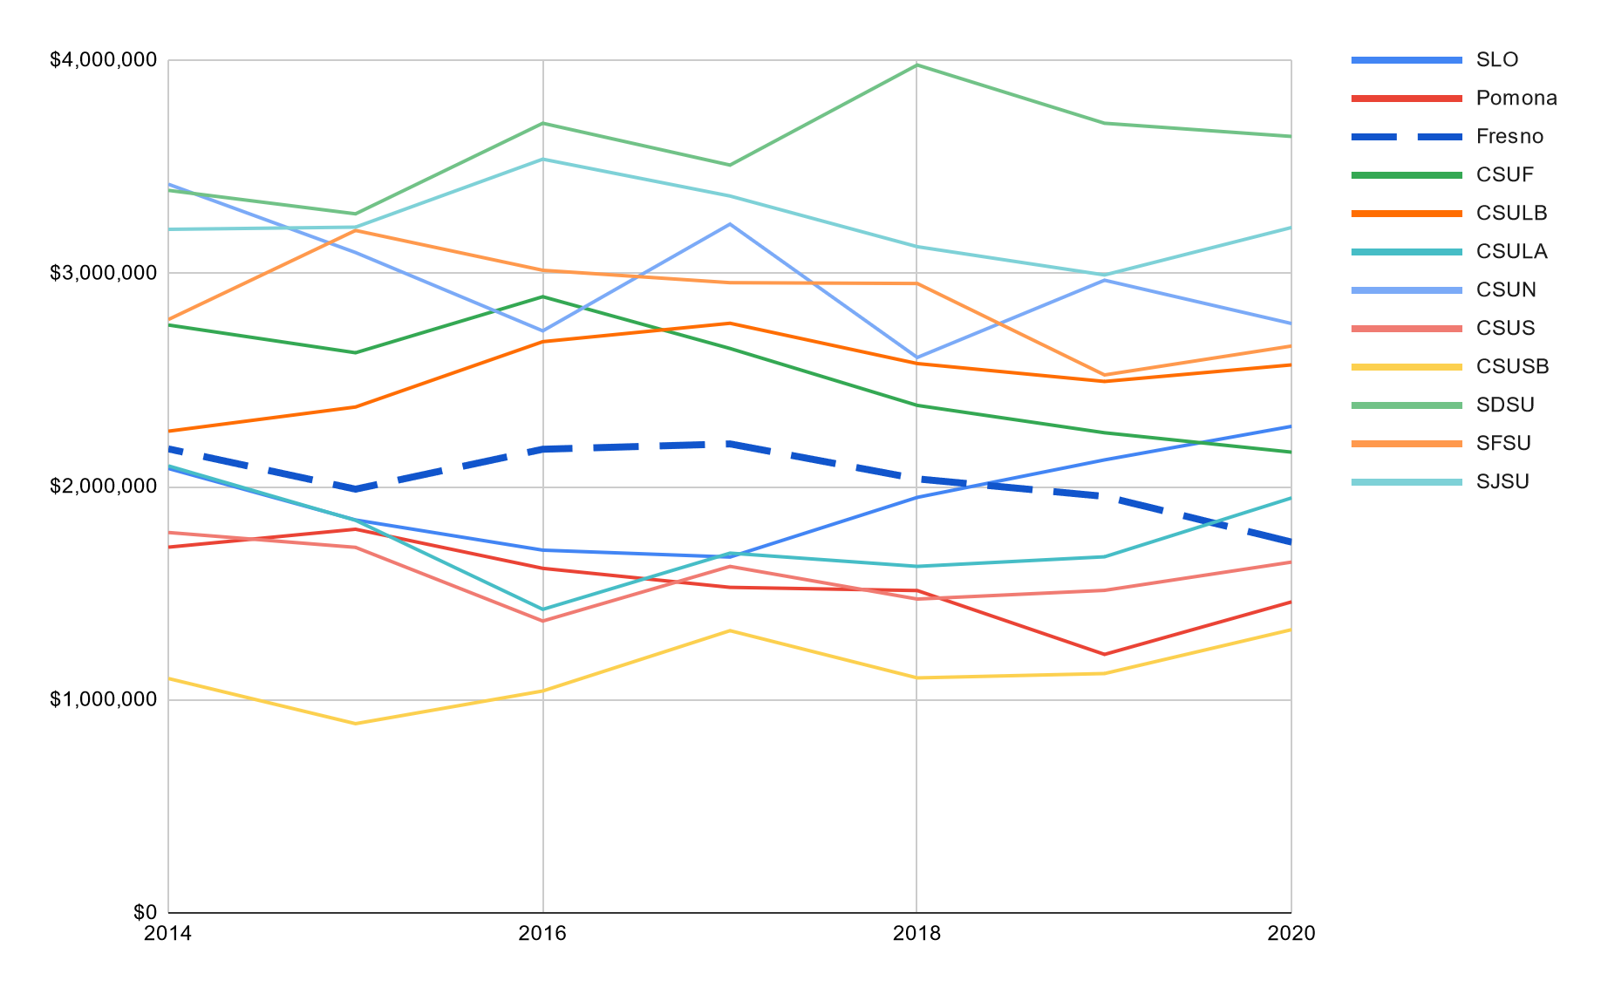
Collections expenditures at other CSUs
Source: Integrated Postsecondary Education Data System (IPEDS)

Slide 6
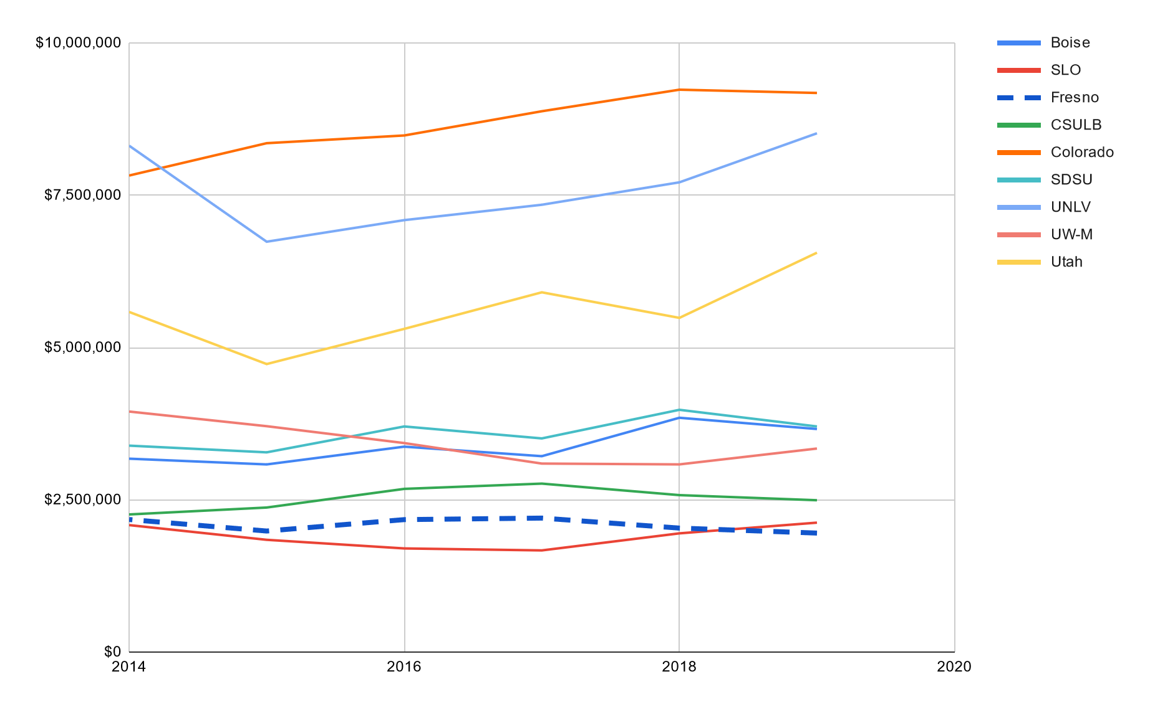
Collections expenditures at peer institutions
Source: Integrated Postsecondary Education Data System (IPEDS)
Source: Commission to Plan for the Future of University Development at Fresno State University (peer institutions)

Slide 7
Data and Resolution
Data: Some contracts only allow California State University, Fresno employees to view prices. Do not share this information. Perpetual purchases and resources from the electronic core collection are not included in these lists. The resources listed for each college were specifically curated to only include items that are primarily used by one or two colleges.
Resolution
Multidisciplinary
College of Arts and Humanities | Craig School of Business
College of Health and Human Services | Jordan College of Agricultural Science and Technology
College of Science and Mathematics | Kremen School of Education and Human Development
College of Social Sciences | Lyles College of Engineering

Slide 8
Additional Funding
Reinstatements LGBT Life Plus Hispanic American Periodicals Index Oxford Reference Oxford University Press Journals RILM Music Encyclopedia Social Explorer | Increase Streaming Media Budget Explore new resources (trials) Roper Center for Public Opinion Research Visible body (3D Anatomy and physiology tools) Ethnic Diversity Sources

Slide 9
Questions?
Contact us:
Kimberley Smith: kimberleys@csufresno.edu
Dolly Lopez: balopez@csufresno.edu
Notes:
Please feel free to contact us if you’d like to discuss this more in depth.

