Slide 1
Updates
President Saúl
October 2, 2023

Slide 2
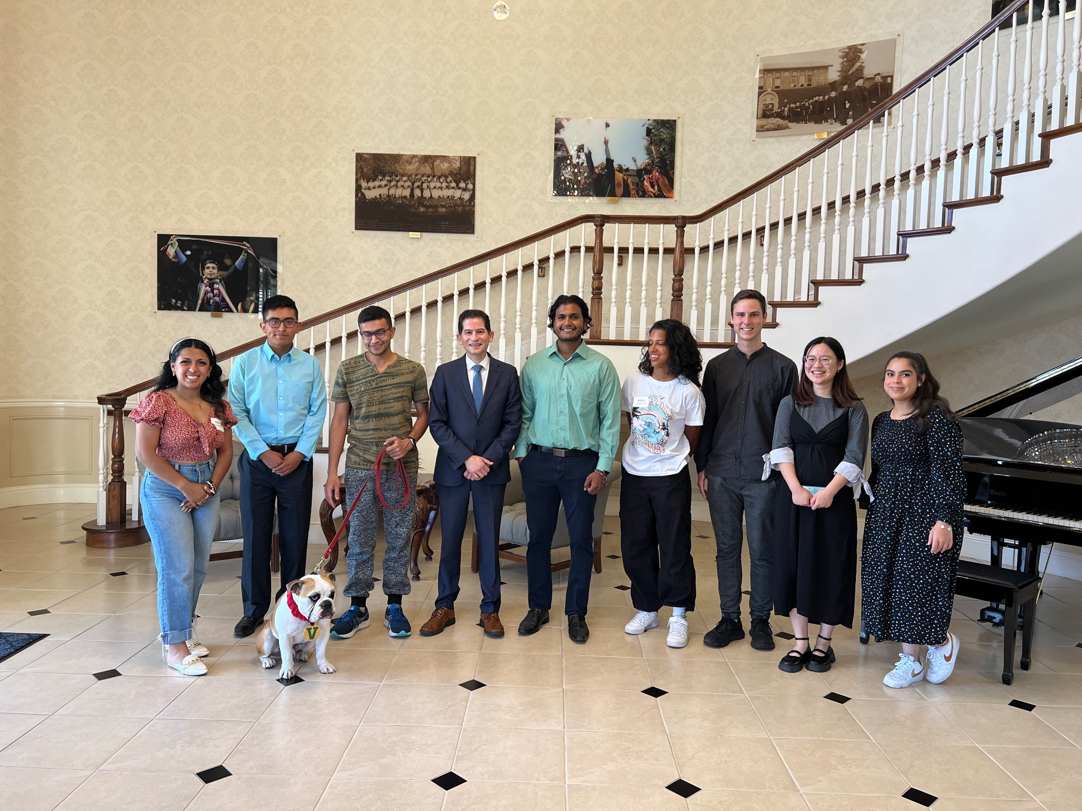
International Student Meeting

Slide 3
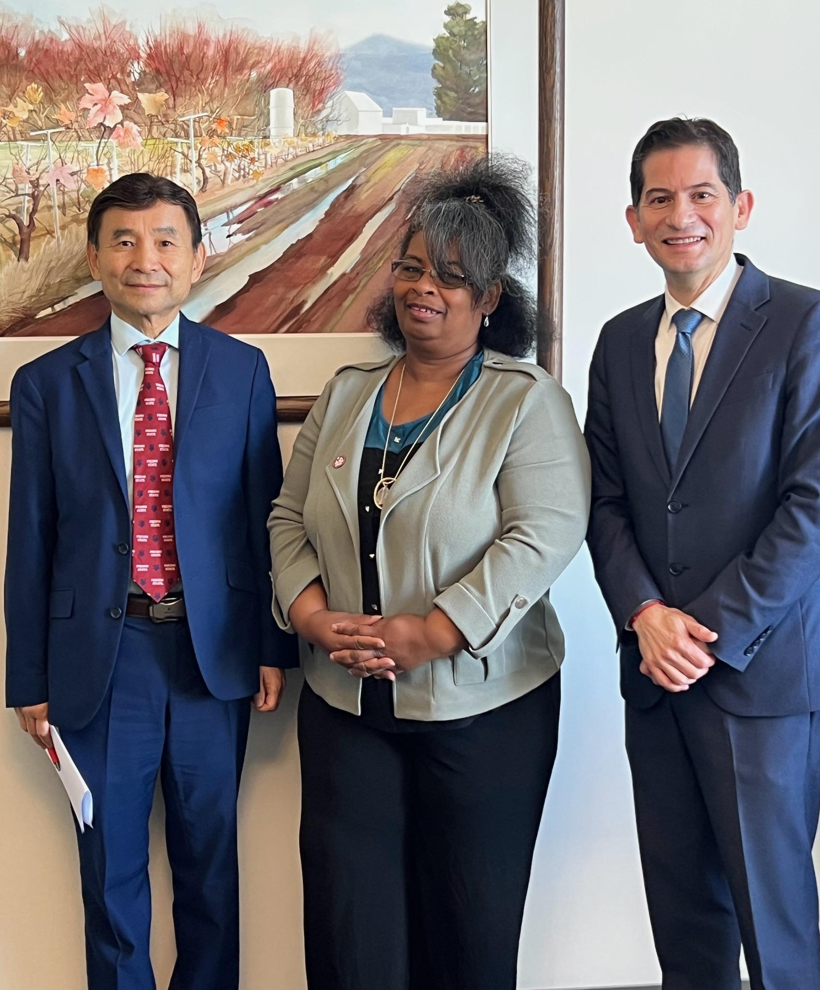
WASC Commissioner Visit
Dr. Tamela Hawley, WSCUC VP
Liaison for Fresno State’s accreditation.

Slide 4
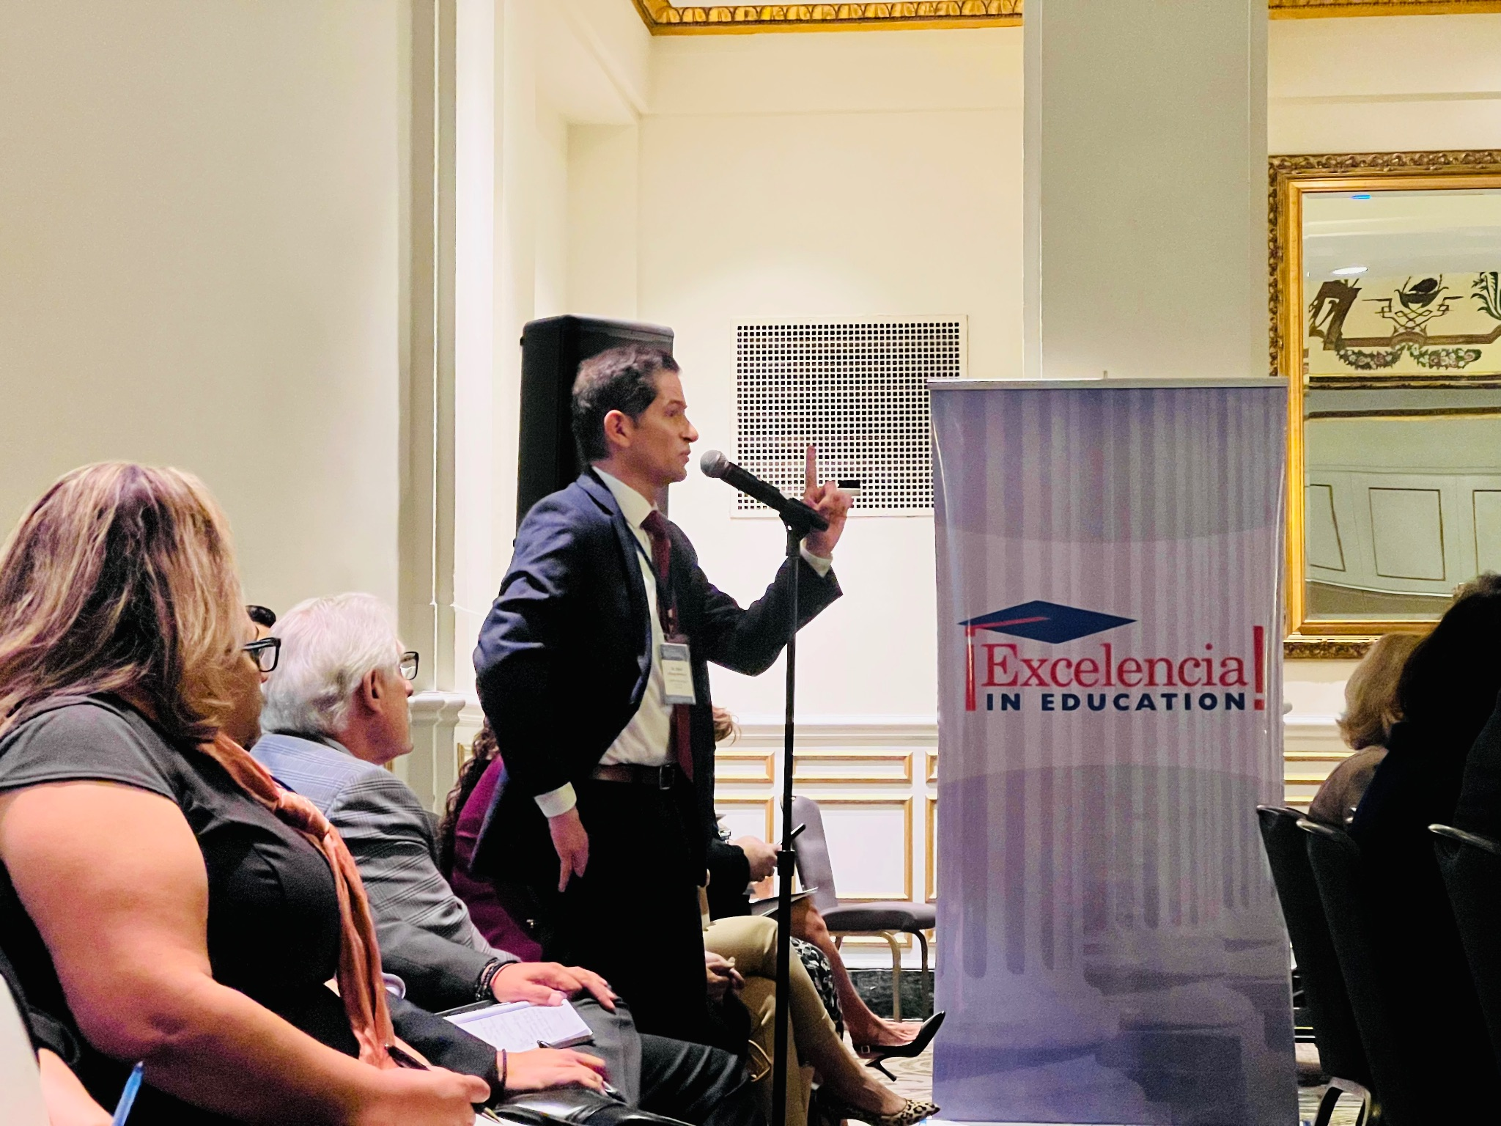
Excelencia in Education Annual Meeting

Slide 5
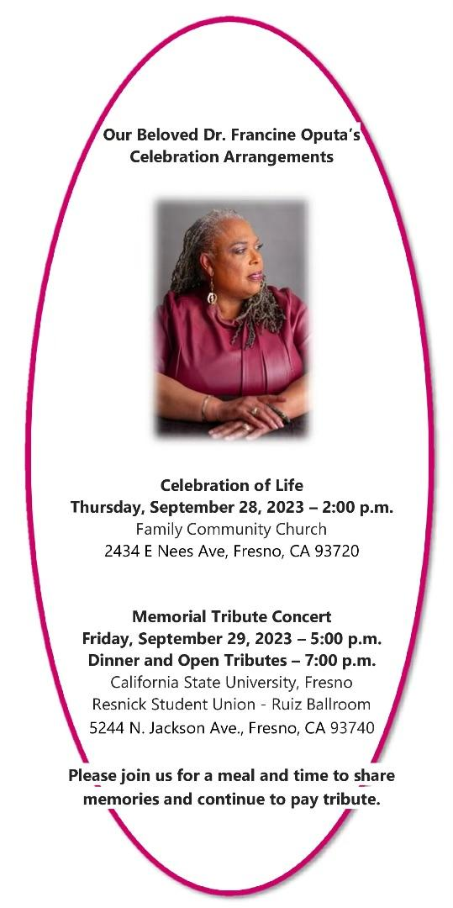

Slide 6
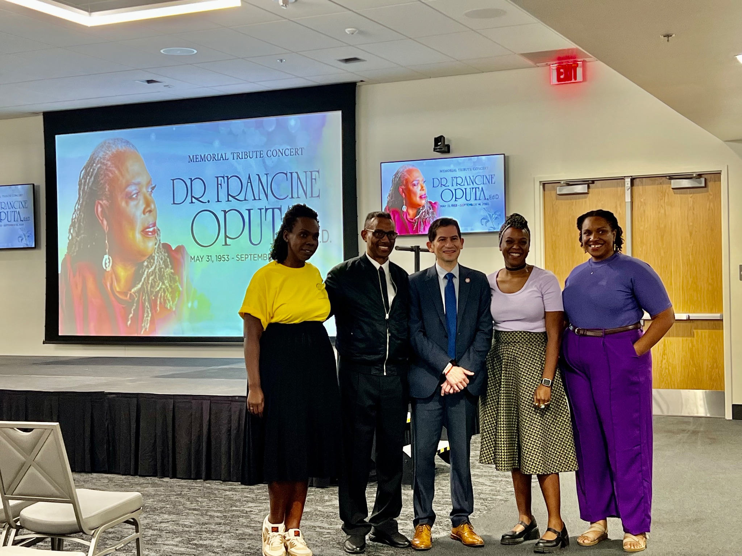

Slide 7
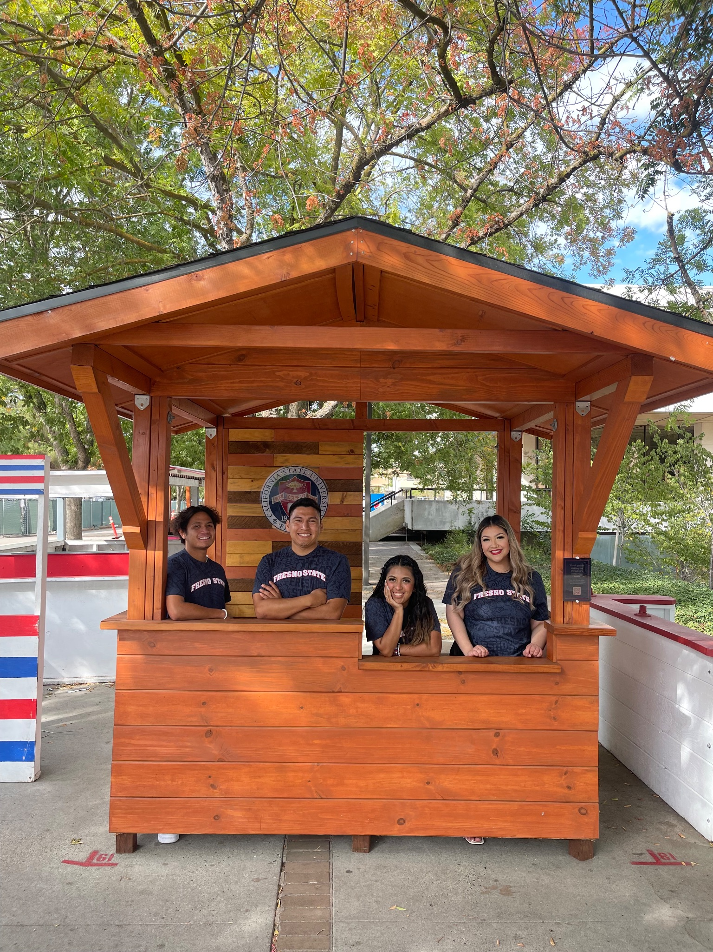
ASI President Nolan Calara, East Bay
ASI President Edgar Mejía-Alezano, Dominguez Hills
ASI President Karen Carrillo, Fresno State
ASI President Nataly Andrade, Sacramento
Not pictured:
ASI President Yahir Flores, Los Angeles

Slide 8
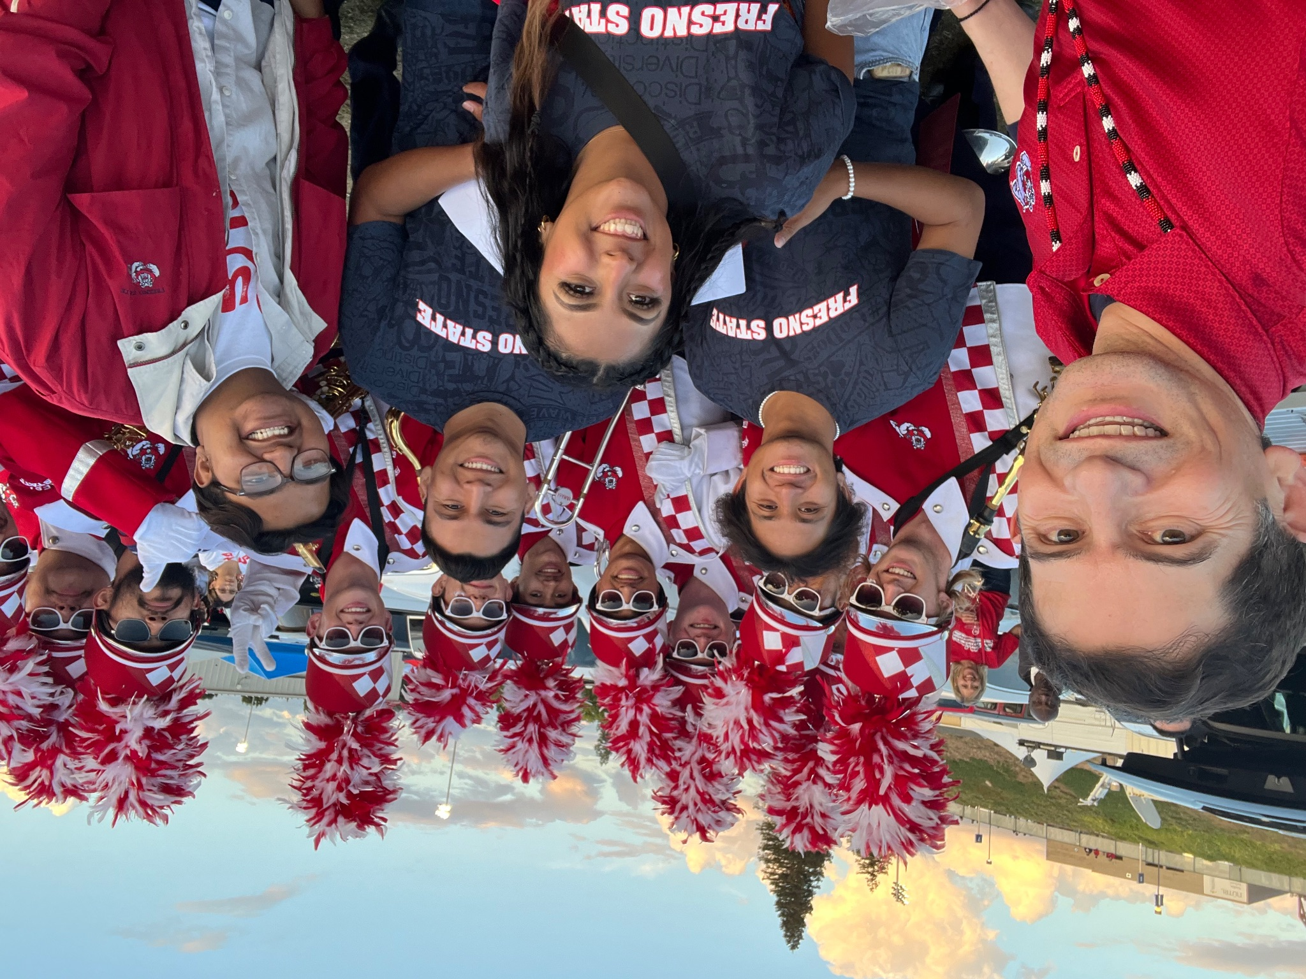

Slide 9
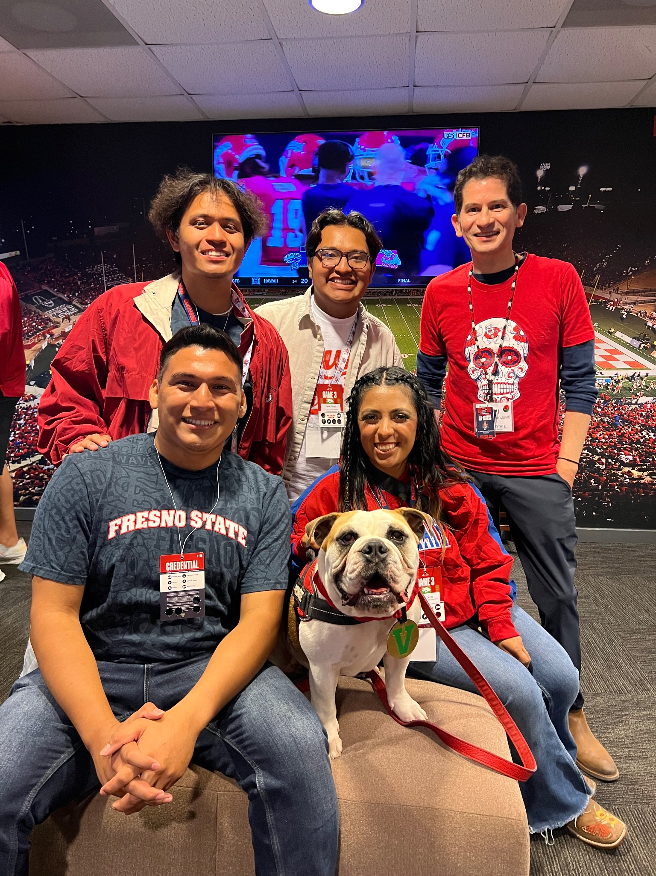

Slide 10
Advisory Boards
Welty:
University Advisory Board
African American
Castro:
Armenian, Jewish, Latinx, Portuguese
SJS:
APIDA (Asian Pacific Islander Desi American)
Native American

Slide 11
President’s Advisory LGBTQ2+ Board
Dr. Kat Fobear, Dr. Peter Robertson, Co-chairs
1) provide communication and updates about the campus climate,
2) offer thoughtful advice to the institution on proactive ways to foster a sense of belonging to LGBTQ2+ students, faculty, and staff;
3) serve as advocates for LGBTQ2+ students and allies.

Slide 12
Pizza with the Presidents

Slide 13
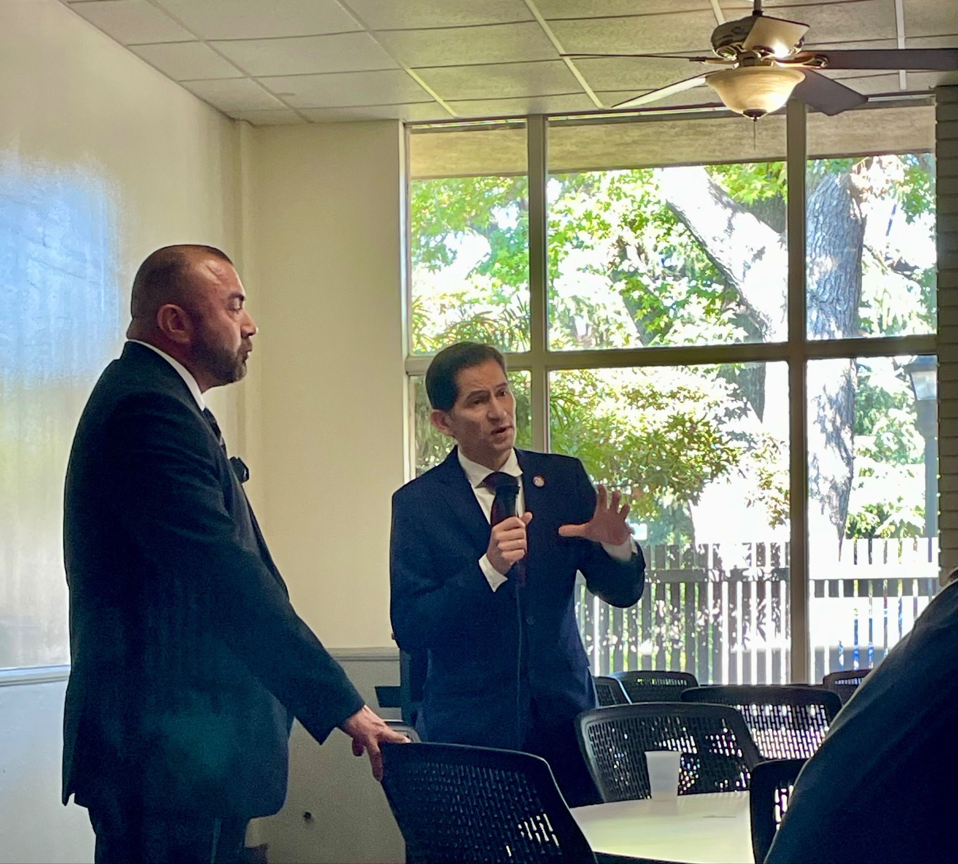

Slide 14
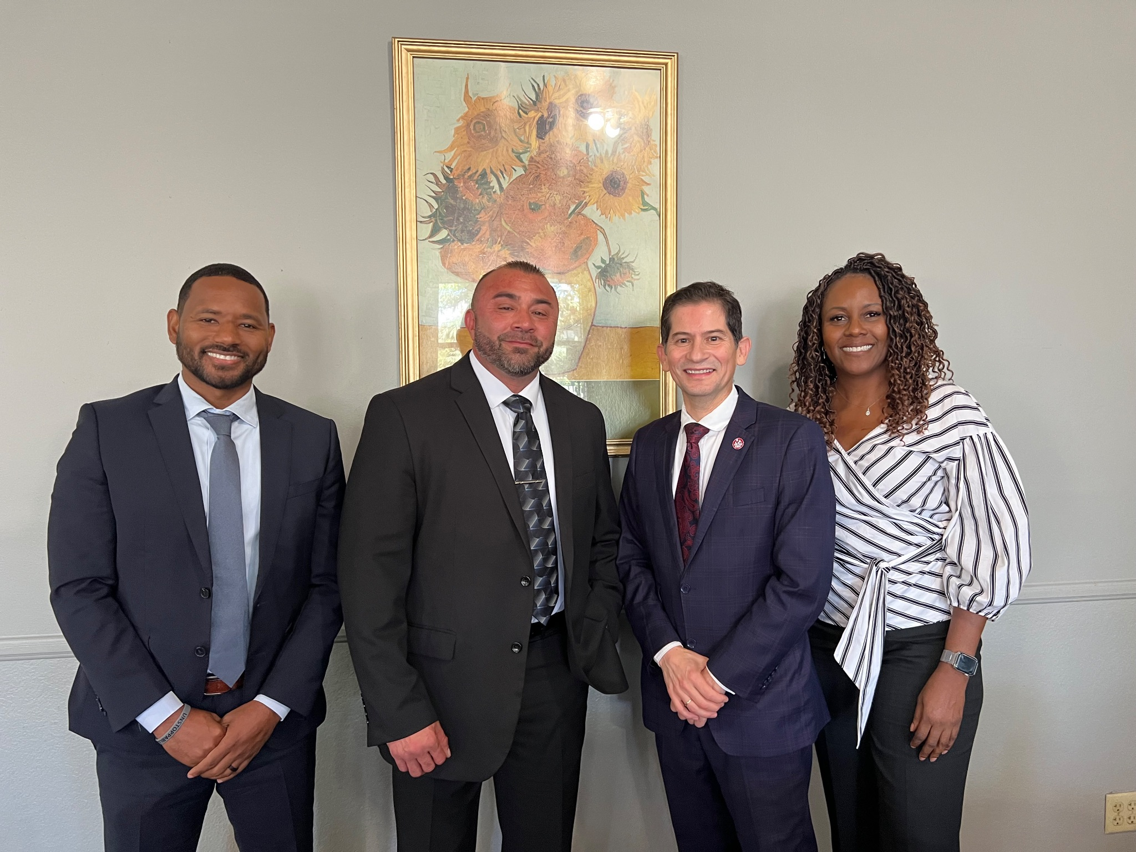

Slide 15
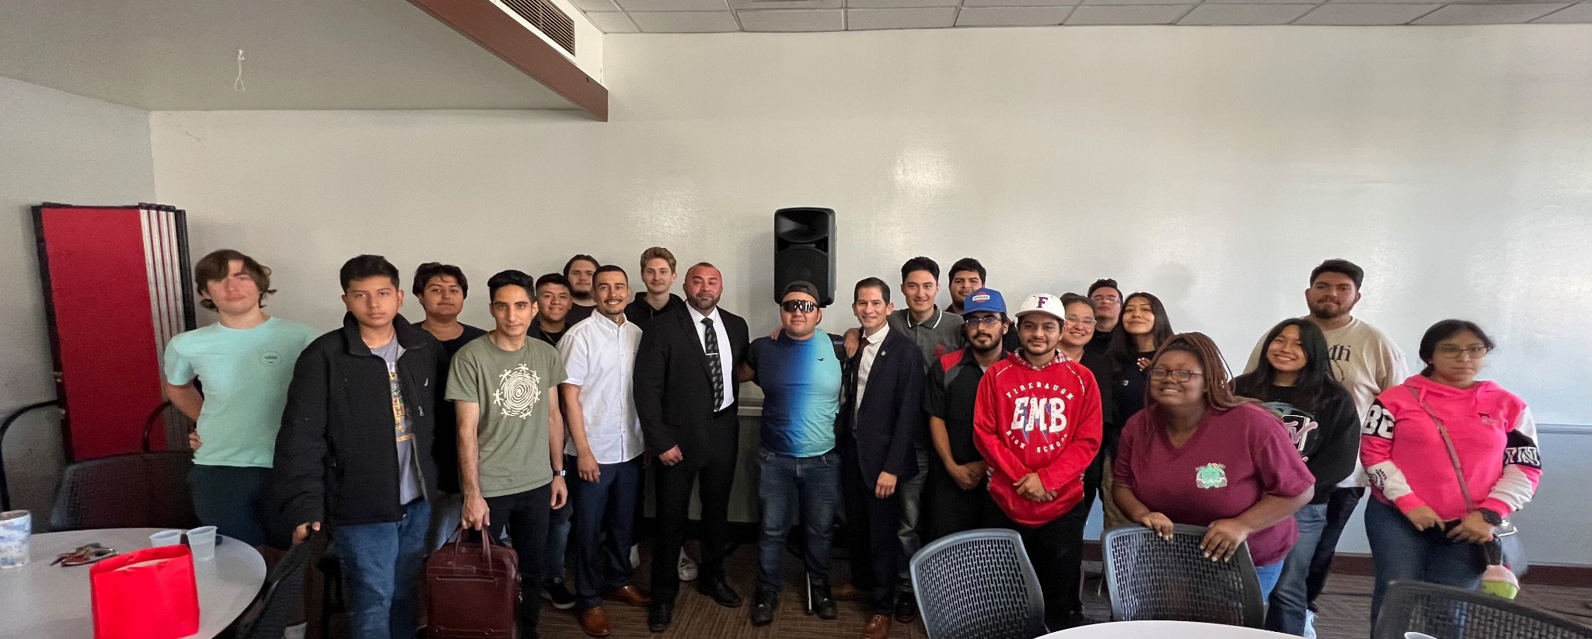

Slide 16
Presidential 3-year Review
Please submit letters or emails no later than November 3, 2023, addressed as follows:
Dr. Mildred García, Chancellor The California State University 401 Golden Shore Long Beach, California 90802-4210 Email: presidentreview@calstate.edu

