Slide 1
April 28, 2021

Slide 2
What value does PaymentWorks bring to Fresno State?
Eliminate Payments Fraud
PaymentWorks
Ensures Compliance
Trust your payee identity information
Eliminate #1 Pain Point in Procure to Pay Process
Notes:
Change this to the value prop slide (see GA slide)

Slide 3
Payee Onboarding: A Time-Saving Process
CFS PeopleSoft
Fresno State
PaymentWorks
Payee (Vendor)
1. Initiate Vendor Invite
2. Approve Request (Optional)
3. Send Invitation
4. Create PaymentWorks Account
8. Create or Update Vendor
7. Approve Workflow
6. Screen (TIN, Sanction, etc.)
5. Complete Registration
9. Notify PaymentWorks
10. Send Notification
11. View Invoices and Remittances
14. Update Record
13. Approve Updates
12. Update Profile Information

Slide 4
Logging In
Fresno State’s Single-Sign-On for PaymentWorks:
www.paymentworks.com/login/saml?idp=csufresno

Slide 5
Search For Payee
Step 1:
Once logged into PaymentWorks, click on Vendor Master Updates.
Step 2:
Next click on the New Vendors tab.

Slide 6
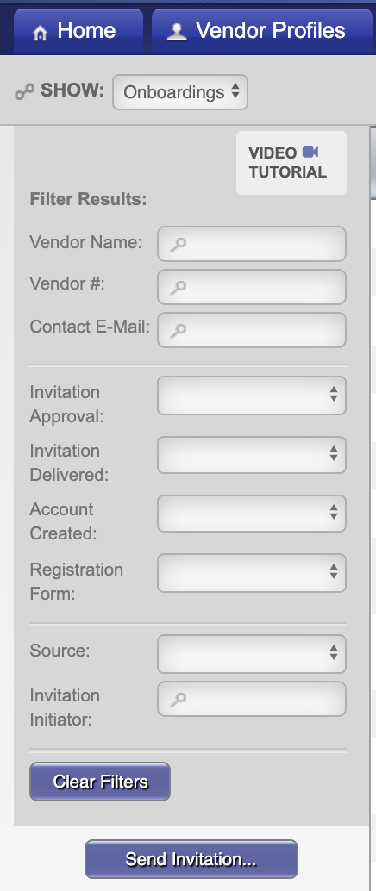
Search For Payee
Step 3:
Under Filter Results, you can now search for the payee via their email address or vendor name.
Next Steps:
This will bring up the request and provide you a status of it. If no results are found, you will need to invite the payee.

Slide 7
Inviting a Payee
Step 1:
Once logged into PaymentWorks, click on Vendor Master Updates.
Step 2:
Next click on the New Vendors tab.

Slide 8
Inviting a Payee
Step 3:
Click on Send Invitation button.
Initiator Video (Link)

Slide 9
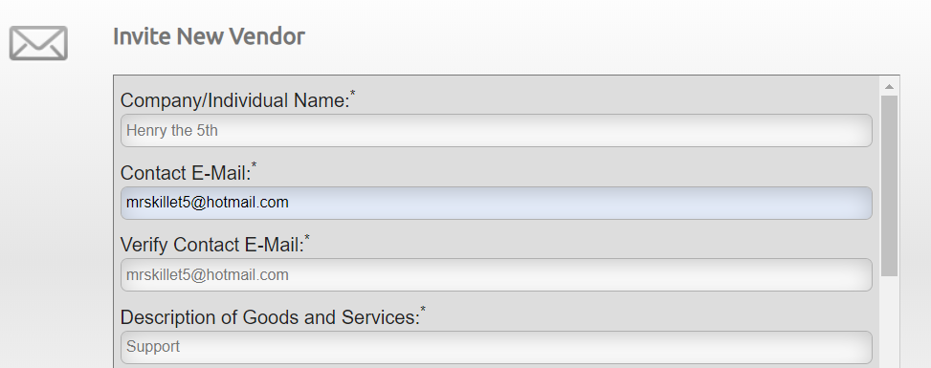
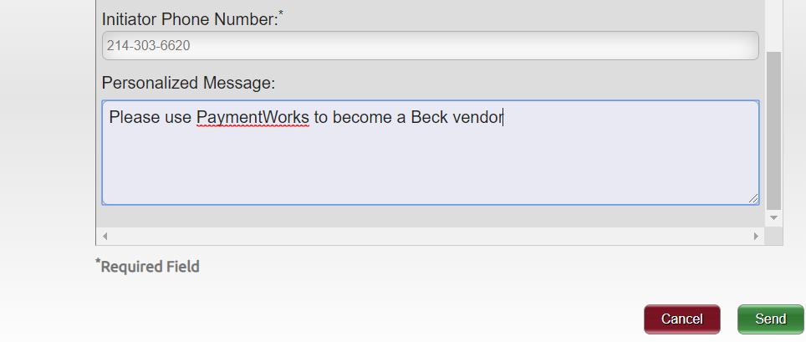
Inviting a Payee
Step 4:
Invite screen will appear. Fill out the form and click “send” button when completed.
A confirmation that the invitation has been sent will pop up, click “Ok”.
Sample Invite

Slide 10
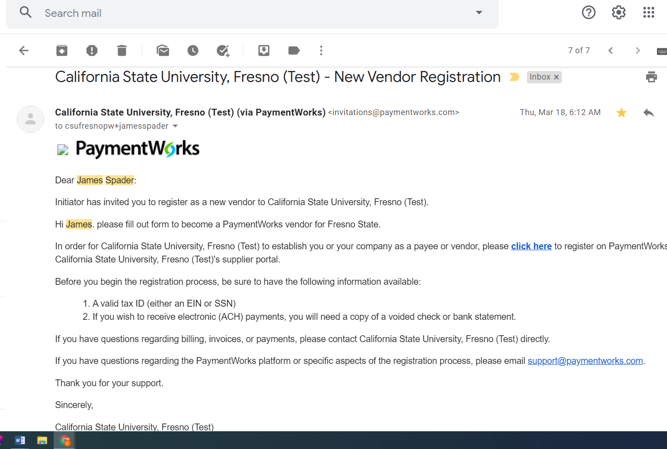
Sample Payee Invitation

Slide 11
Review Invite Status
Step 1:
Confirm you are on the Vendor Master Updates page.
Step 2:
Click on the New Vendors tab.

Slide 12
Review Invite Status
Step 3:
Under column labeled “Invitation” you can review the status.

Slide 13
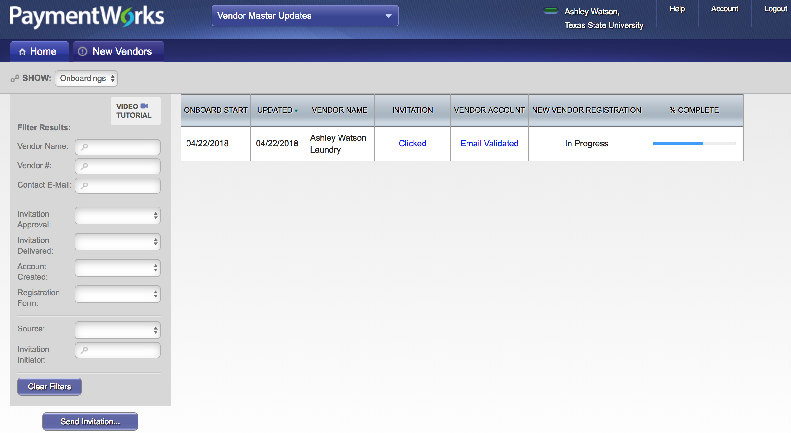
Tracking Onboarding
Invitation column:
Pending Approval
Opened
Clicked
Rejected
Undeliverable
Cancelled
Vendor Account Column:
No Account
Registered
Email Validated
New Vendor Registration column:
Not Started
In Progress
Submitted
Returned
Approved
Rejected
Complete
Processed
On the Vendor Master Updates page, click on the New Vendors tab.
Here is where you can track the status for Payees.

Slide 14
Tracking Onboarding
Status | Explanation
Pending Approval | Invitation is in queue to be reviewed.
Opened | Vendor has opened the invitation email.
Clicked | Vendor has received the invitation email and clicked on the link to get started.
Rejected | Buyer has rejected the invitation request.
Undeliverable | Invitation delivery was unsuccessful. This usually indicates the contact email address was invalid.
Cancelled | The invitation has been cancelled.
Invitation Statuses

Slide 15
Tracking Onboarding
Status | Explanation
No Account | Vendor has not used their invitation to create their account.
Registered | Vendor account was created but not activated.
Email Validated | Vendor has created and activated their account.
Account Statuses

Slide 16
Tracking Onboarding
Status | Explanation
Not Started | Vendor has not entered information on their registration.
In Progress | Vendor has started entering information on the registration but has not submitted.
Submitted | Vendor has submitted their registration.
Returned | The registration has been returned to the vendor in order for a correction to be made. The vendor will be emailed directly with the requested correction. They will also receive a message in their “Messages” tab.
Approved | The registration has been approved.
Rejected | Vendor has rejected the registration.
Complete | The vendor has been notified of their approval, the vendor record has been created, and the vendor number has been issued. The vendor number will appear under “New Vendor Registration”.
Processed | The registration has been processed and sent to your system of record.
Registration Statuses

Slide 17
Tracking Onboarding
When you see the Vendor# under the New Vendor Registration column, this indicates the Payee is available to use.

Slide 18
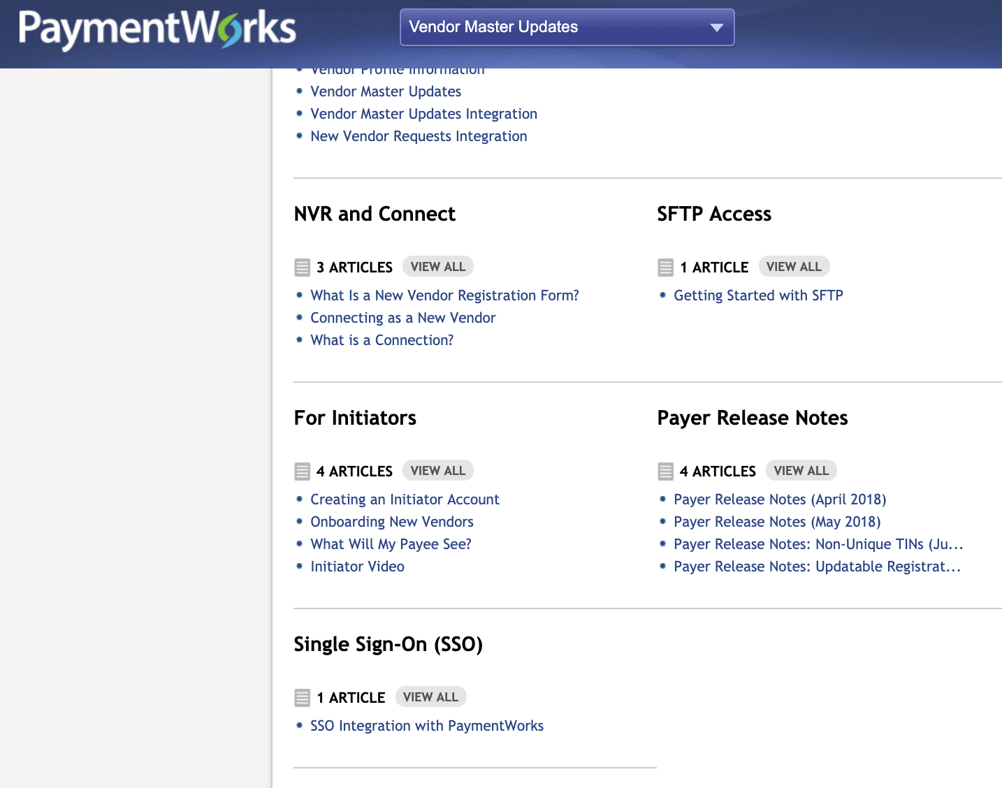
Online Help
At the top right corner of your PaymentWorks screen, you can click on “Help”.
Now if you scroll all the way down, on the bottom left you will see Initiator help section.
You can also click on the video tutorial button on your onboarding screen.

Slide 19
Troubleshooting
.
How will I know when the supplier is connected?
The initiator will receive an email from PaymentWorks when the integration process is completed, and a vendor number is assigned and can status on the onboardings screen.

Slide 20
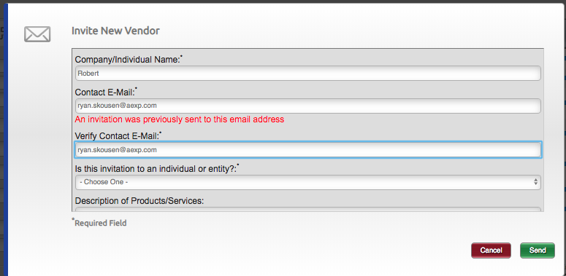
Troubleshooting
Error when sending Payee invitation. “An invitation was previously sent to this email address”
PaymentWorks does not allow multiple invitations to be sent to a single email. Someone else may have previously sent the invite.

Slide 21
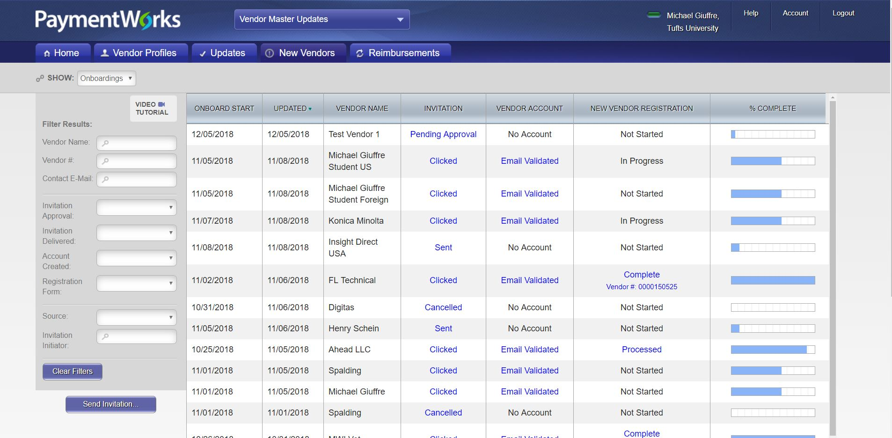
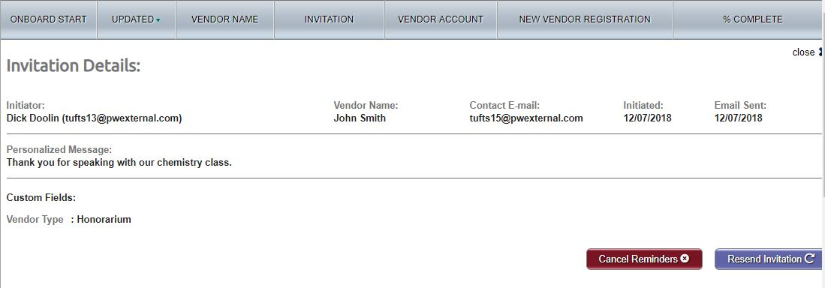
Troubleshooting
My payee did not receive the invite
Verify that the payee has checked their spam folder
Initiators have the ability to re-send an invitation. To resend invitation:
Click the status in the Invitation column.
At the bottom of the Invitation Details screen click “Resend Invitation” button.

Slide 22
Troubleshooting
Entered the wrong email address
Departments can correct and re-send invitations with the following invitation statuses: Sent, Delivered, Not Deliverable. To re-send invitation with the correct email address:
Click on the invitation status.
Then click on the ”Resend Invitation” button.
Enter correct email address under “Contact E-Mail”
Click on the “Send” button when finished.

Slide 23
Troubleshooting
The payee will receive emails until the registration is completed or the reminders are cancelled.
Reminder email notifications are automatically generated, do not re-send invitations unless the payee notifies you that they did not receive the initial email
1st reminder – three days
2nd reminder – seven days
3rd reminder – 14 days
4th reminder – 21 days
5th reminder – 28 days
My payee has not completed the forms

Slide 24
Troubleshooting
I haven’t received my Vendor #
You will receive your Vendor # once the payee has been approved and sent to the ERP

Slide 25
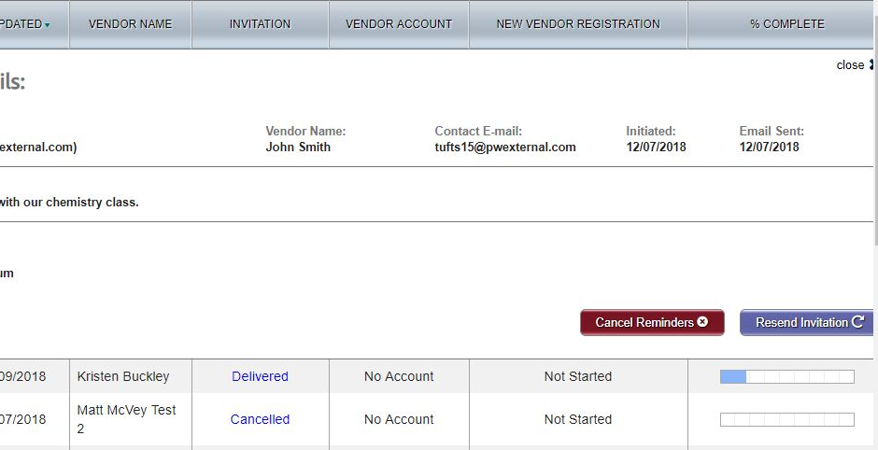
Troubleshooting
My payee will no longer be used
Click on the invitation status.
Then you will want to click on the “Cancel Reminders” button.
A confirmation screen will appear, click on the “OK” button.

Slide 26
Troubleshooting
What is the recommended browser to use?
Chrome

